Slide 2
Jan-Tore Pedersen
Understanding what Azure Stack HCI is and how it fit's in your Datacenter

Slide 3


Jan-Tore Pedersen
Managing Consultant @Spirhed
Cloud and Datacenter MVP
Blog: https://jtpedersen.com
Twitter: @jantorep
Speaker and Organizer for MMUG.no
Azure Stack HCI S2D/Hyper-V
System Center
Software-defined Datacenter
Azure
Azure Stack HUB

Slide 4
Azure Stack HCI

Slide 5



What is hyperconvergence?
Legacy “three tier” infrastructure
Ethernet switches
Misc. appliances
Hyperconverged infrastructure (HCI)
Ethernet switches
Hypervisors
Standard x86 servers
+
Local drives
+
The magic of software
Storage fabric
Storage (SAN)
Notes:
This slide introduces the concept of hyperconvergence. It relies on software defined storage and networking to enable aggregation of all server resources into a virtual pool that can be accessed directly from any of the servers in the cluster. Hyperconvergence eliminates the need for SAN, storage switches and network appliances…. Customers are left with servers and their internal disks, ethernet switches. Hyperconvergence reduces physical footprint, reduces the power and cooling requirements and greatly simplifies management.

Slide 6



Runs on your servers, on your premises
Learn more at Azure.com/HCI
Baremetal OS
Azure Stack HCI OS
Azure Stack HCI OS
Azure Stack HCI OS
Industry-standard
OEM servers
Your physical premises

Slide 7





Scale with your needs
Scale up, scale out
From 1 Up to 16 servers per cluster
Up to 16 PB storage capacity per cluster
With no downtime
Automatic VM load balancing
Automatic storage rebalancing
Add servers
to the cluster
Add drives
into existing servers

Slide 8
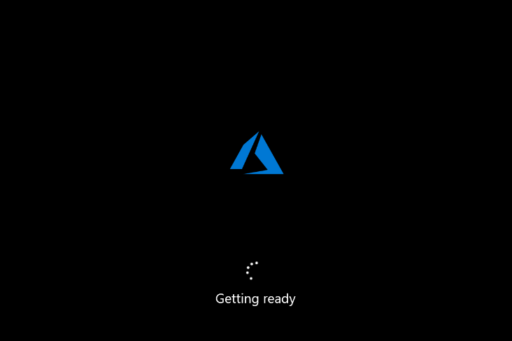
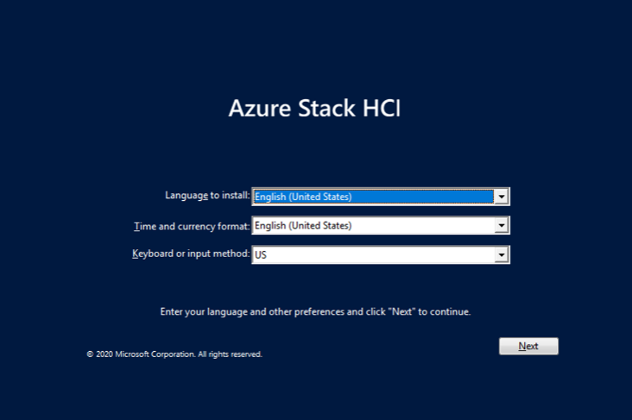
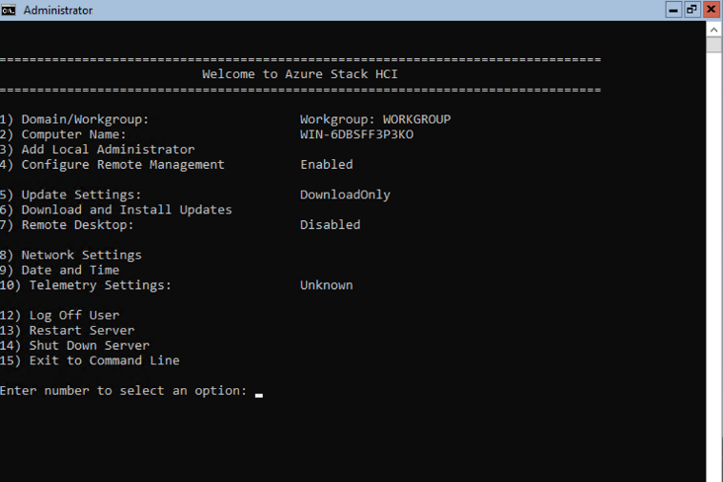
Specialized host operating system
Latest Azure hypervisor with built-in software-defined storage and networking
Optimized for virtualization with reduced composition
Minimal local user interface, designed for remote management

Slide 9
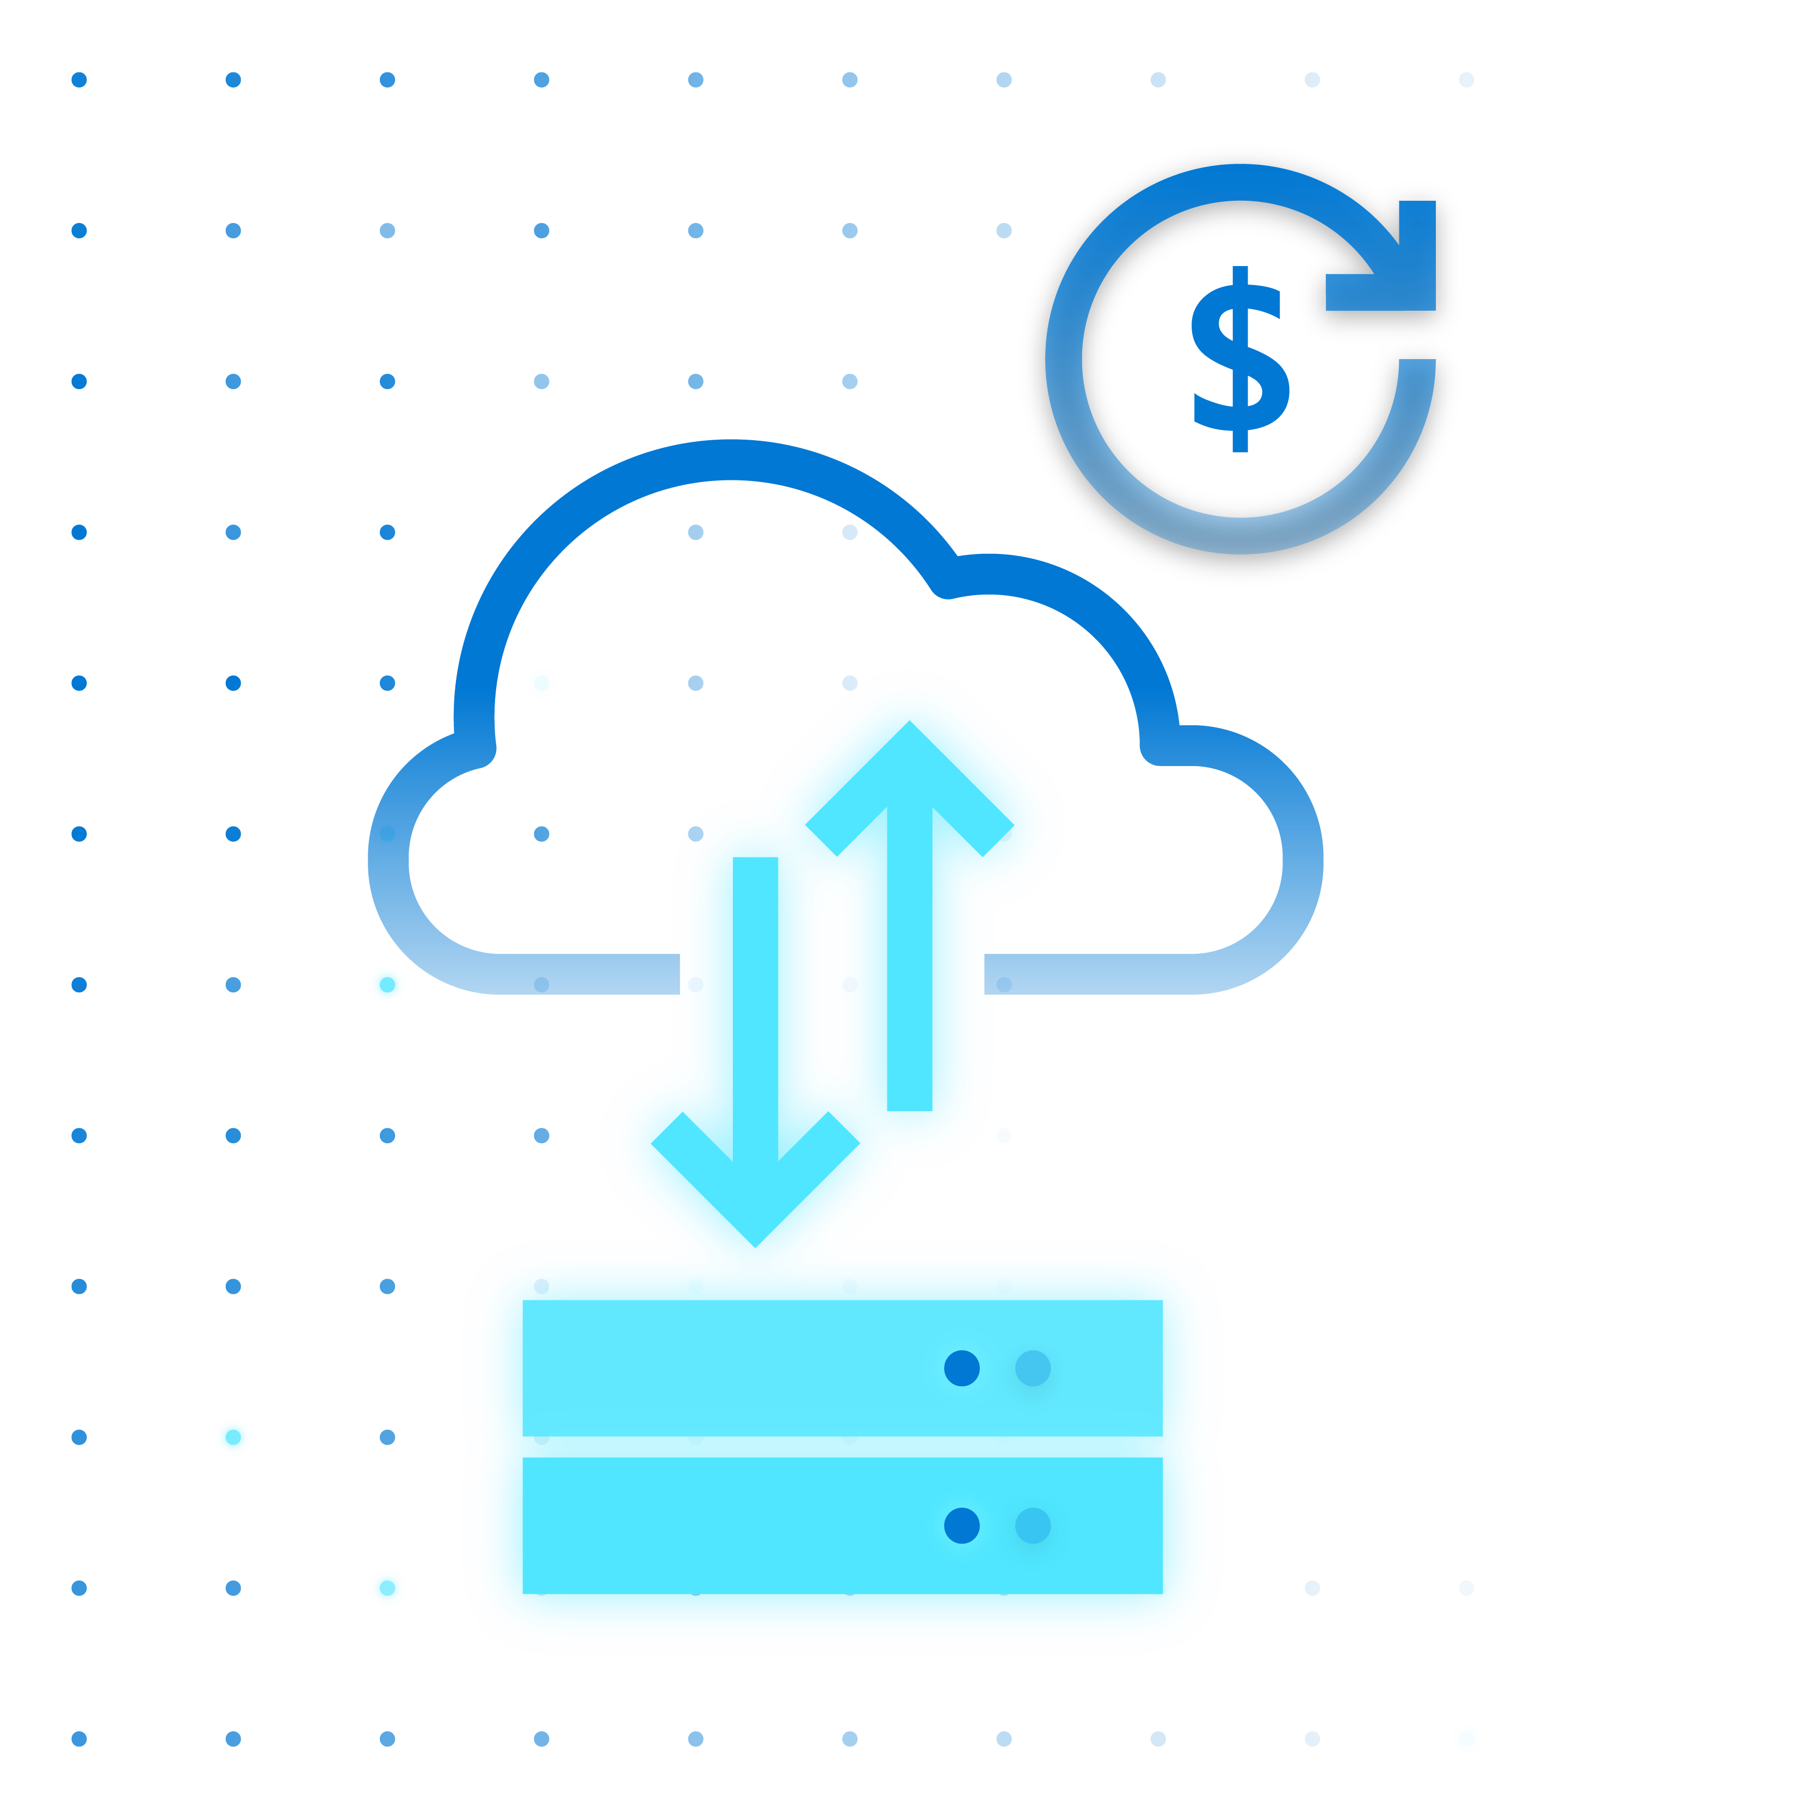



Azure Stack HCI
Modern subscription for flexible, familiar hyperconverged infrastructure
Azure hybrid by design
Enterprise scale and price performance
Familiar management and operations
Choice of deployment options

Slide 10
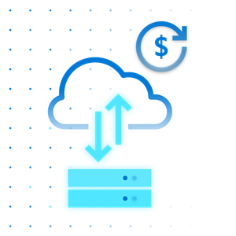
Azure hybrid by design
Native integration with Azure Arc and Azure Monitor
Connect to hybrid services like Azure Security Center, Azure Backup, and Azure Site Recovery
Monitor and manage clusters at scale from Azure
Centrally manage VMs from Azure Portal
Fleet management for hosts and VMs
Azure hybrid by design
Always up to date HCI as a service ​
Regular and consistent feature and security updates
Unified Azure billing
Leverage existing Azure support plan

Slide 11

Industry leading price-performance
Millions of IOPs and batch requests with Storage Spaces Direct
Optimized for SQL Server virtual workloads
Per physical core monthly subscription to scale up or down
Secure virtualization platform for Windows and Linux
Unlimited hosting of Linux VMs
Choice of licenses available for Windows VMs
Secured-core server supported for ultimate enterprise security
Includes Extended Security Updates (ESU) for Windows Server 2008/R2
Enterprise scale & price-performance
Built-in HA/DR
New simple deployment GUI for clusters available through Windows Admin Center
Stretch cluster: extend HCI cluster from a single site to two sites
Protect VMs with cloud backup

Slide 12

Leverage existing skills
Built on foundation of Windows Server and Hyper-V
Familiar tools like Windows Server Admin Center and Azure Portal
Support for Active Directory, Group Policy Object
Work with popular tools
Work with familiar Microsoft tools such as System Center and Windows Admin Center
Compatible with popular third-party tools such as Altaro, Datadog, Commvault, Veeam, Veritas, etc.
Familiar management and operations
Benefit from automation
Management tasks are completely scriptable using popular, cross-platform Windows PowerShell framework

Slide 13

Choice of Validated Nodes or Integrated Systems
Validated nodes based on standardized reference architecture
Available Integrated Systems for fastest time to value: pre-installed software and integrated drivers and firmware
Extensive choice of hardware partners
Choose your preferred vendor for local support and delivery
Flexible sizing available from small to rack class options
Choice of deployment options
Possible to use existing hardware
Reuse your existing hardware if it matches a validated node solution in the Azure Stack HCI catalog

Slide 14
Azure Stack HCI: hardware deployment scenarios
Recommended for fastest time to value
3 hardware vendors offer integrated systems (more to come)
Simple to deploy and procure
New full stack update feature in Azure Stack HCI and Windows Admin Center makes upgrades, maintenance and management super easy for customers
Ideal for customers who require turn-key solutions with little deployment effort from IT staff
Joint support agreement with partners with ticket exchange between partner and Microsoft
“Fully integrated” appliance-like experience
Azure Stack HCI
Integrated Systems
Broadest choice of hardware components
More diverse configurations for demanding workloads, some customization due to diversity of solution offerings
Ability for customer to engage with preferred SI for deployment and integration if needed
Existing hardware can be repurposed as long as it matches a current validated node solution in the Azure Stack HCI catalog
Separate support for hardware and software
Historically, validated nodes are the most popular hardware scenario
Azure Stack HCI
Validated Nodes
Reference architecture “like”
Azure Stack HCI Validated Nodes
On new hardware
- OR -
Reuse existing hardware if it matches a configuration in the Azure Stack HCI Catalog
1. On new hardware
2. Reuse existing hardware if it matches a configuration in the Azure Stack HCI Catalog
Visit the Azure Stack HCI Catalog to find the validated hardware offerings from our global partners​

Slide 15
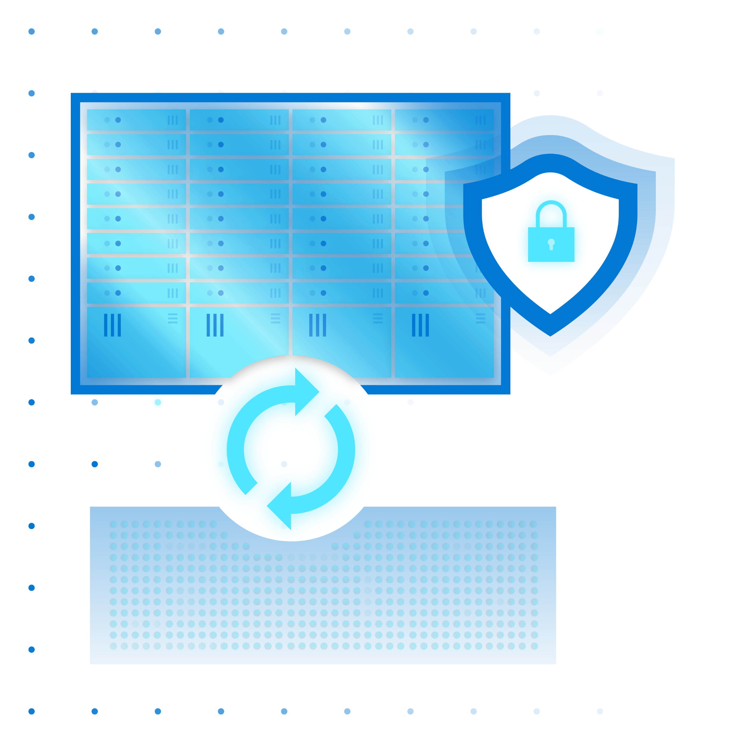

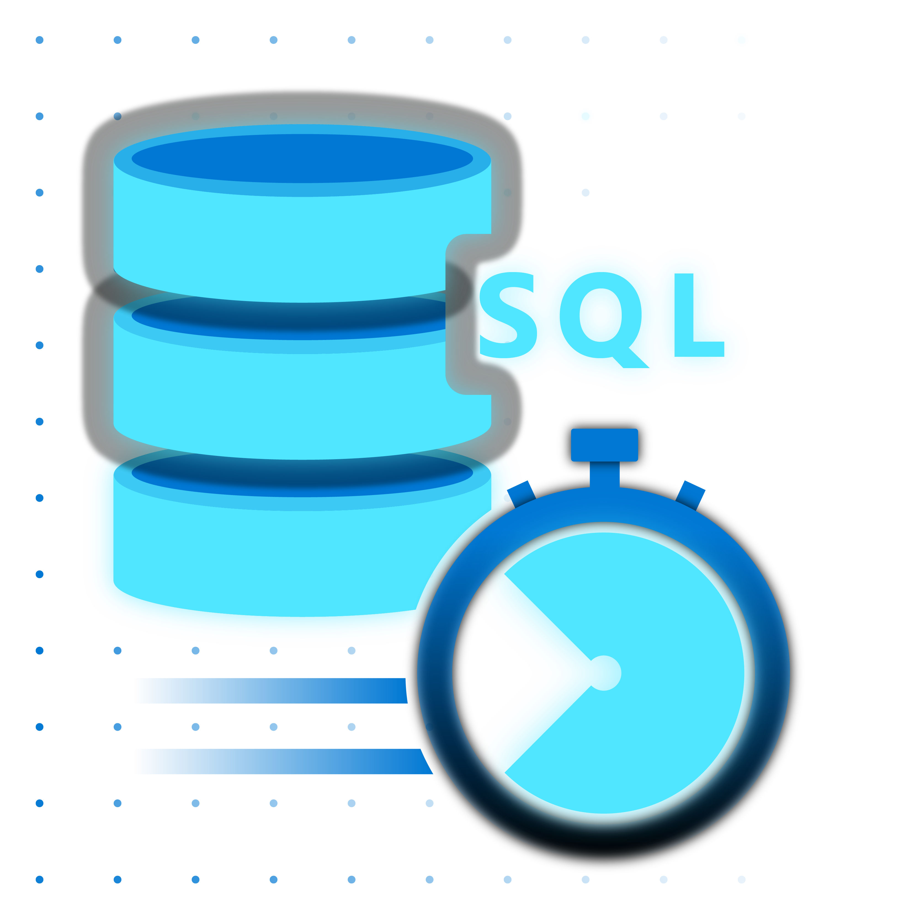




When to use Azure Stack HCI
Run virtual machines on-premises and easily connect to Azure hybrid services
Modernize and secure your datacenter
Affordably run intelligent edge and remote branch solutions
Industry-best performance for SQL Server databases
Deploy cloud native apps and Azure Arc enabled services through tight integration with AKS on HCI

Slide 16
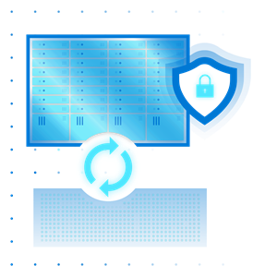
When to use Azure Stack HCI
Modernize foundation infrastructure
Bring requirement for trusted enterprise virtualization by providing a highly secure infrastructure for workloads through virtualization-based security (VBS)
Secured-core server supported for ultimate enterprise security
Benefit from no cost Extended Security Updates when migrating Windows Server 2012/R2 workloads
Gain better efficiency and lower costs
Reduce server racks footprint and lower cooling and utility costs
Lower CAPEX by upgrading from legacy storage
Modernize and secure your datacenter
Simplify governance
Reduce the elements that need to be managed and supported
Simplify operations with unified tools and a single point of support

Slide 17

When to use Azure Stack HCI
Provide efficient IT infrastructure resources
Bring efficient IT to remote locations at the right price by leveraging switchless deployment and “true” 2 node clusters
Ensure high availability and storage resiliency
Even at your remote location, Storage Spaces Direct provides storage resiliency for 2 nodes
Leverage nested resiliency and cloud quorum technologies
Intelligent edge and remote branch solutions
Manage your distributed clusters from a “single pane of glass”
Leverage integration with Azure and Azure Arc enablement

Slide 18
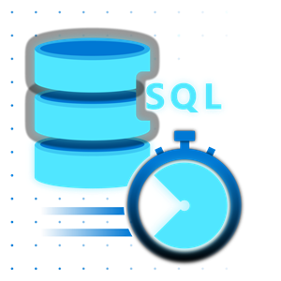
When to use Azure Stack HCI
Millions of storage IOPS and database transactions possible
Leverage the kernel embedded architecture to ensure great performance for demanding SQL Server based applications
Fastest HCI industry benchmark for virtual SQL Server workloads on a 4-node cluster
Benefit from very low latency
Azure Stack HCI supports NVMe, RDMA and persistent memory
Industry-best performance for SQL Server databases (in VMs)
Accelerate Azure Data Services and Big Data clusters at the edge

Slide 19
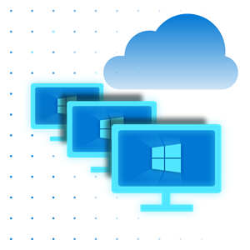
When to use Azure Stack HCI
Bring a container managed platform to your on-prem environment enabling running PaaS like service on-prem
Deploy cloud native apps in AKS such as cognitive services and deploy unmodified to the edge
Deploy cloud native apps and Azure Arc enabled services leveraging AKS on HCI
With built-in resiliency, ideal platform to run Azure Arc enabled services like data services

Slide 20
Azure integration and making it hybrid

Slide 21
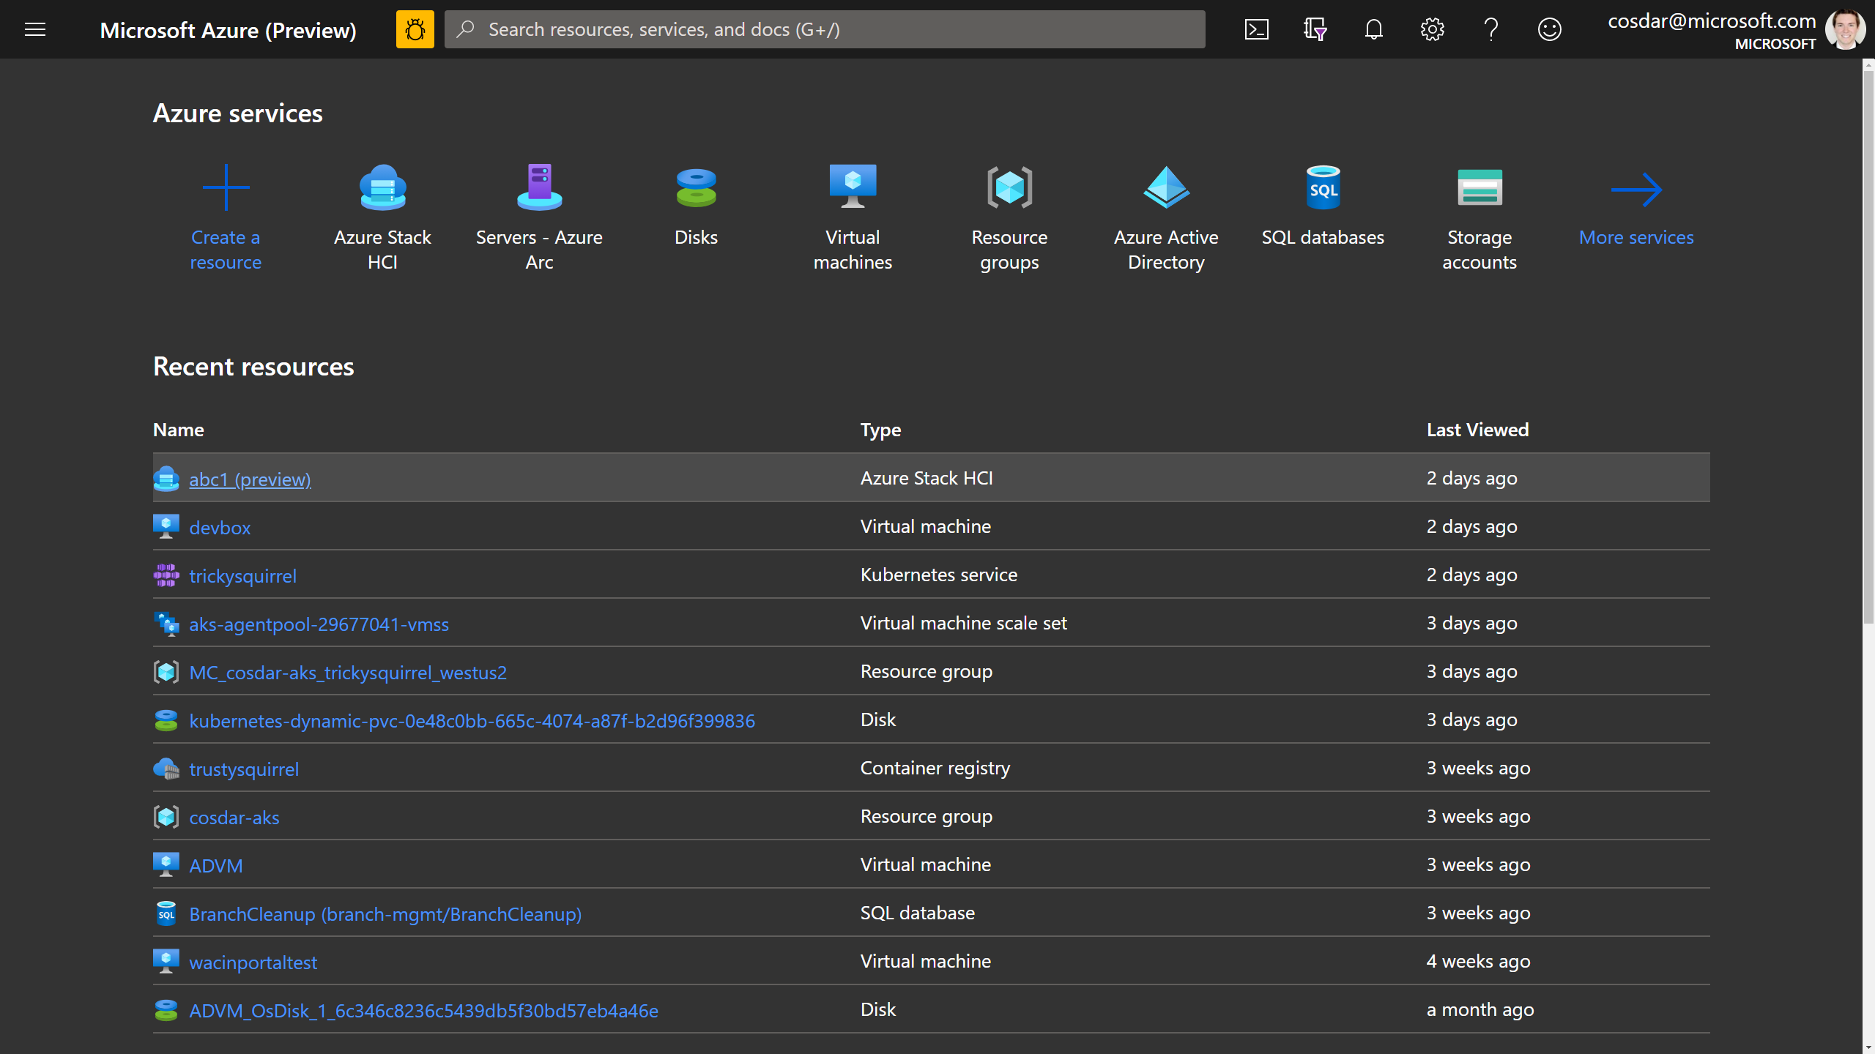


Simplify hybrid with native Azure integration
Azure Resource Manager (ARM) resource represents each on-premises Azure Stack HCI cluster
Visibility in the Azure Portal and foundation for hybrid management
No fuss with agents or scripts – it’s built-in!
Azure Active Directory
Subscription
Azure Stack HCI
Resource Provider
by Microsoft
Resource Group
Resource for
Azure Stack HCI
Azure Portal
Cloud
On-premises
Server 1
Server 2
Server 3
On-premises cluster

Slide 22
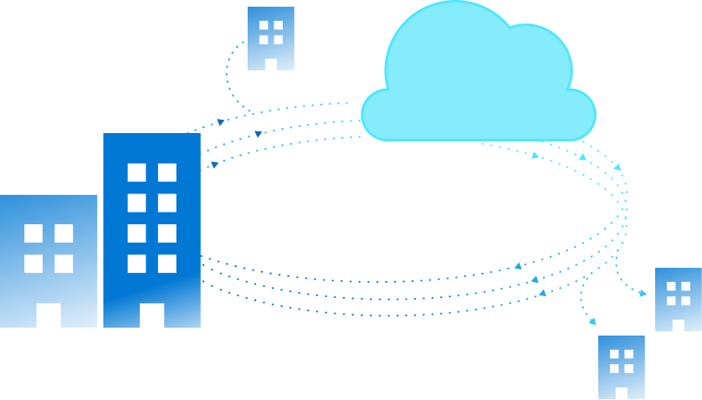
How do you use hybrid?
Extend on-premises into Azure
Offsite backup and disaster recovery
Extend on-premises capacity
Centrally manage from Azure
Centralized update management
Cloud-based monitoring
Security and advanced threat protection
Centralized governance across environment

Slide 23





Azure Stack HCI & hybrid via Windows Admin Center
Azure Stack HCI host
Guest VMs
Extend on-premises into Azure
Offsite backup and disaster recovery
Extend on-premises capacity
Azure Site Recovery
Azure Backup
1 0 0 1
Cloud Witness
Azure File Sync
Centrally manage from Azure
Centralized update management
Cloud-based monitoring
Security and advanced threat protection
Centralized governance across environment
Azure Security Center
Azure Monitor
Azure Update Management

Slide 24
Azure Kubernetes Service on Azure Stack HCI AKS on HCI

Slide 25


AKS on Azure Stack HCI
Familiar Kubernetes application platform available on Azure Stack HCI
+
+
Azure hybrid by design
Best platform for .NET apps on-premises
Built-in security
AKS-consistent Kubernetes cluster management
Easy AKS deployment on Azure Stack HCI
Built-in Azure Arc capability
Support for both Linux and Windows applications
Differentiated container solution for Windows
Local administration with Windows Admin Center
Secure and trusted platform
Single and consistent identity
Always up-to-date like Azure

Slide 26

When to use AKS on Azure Stack HCI
Run Kubernetes on Azure Stack HCI and easily connect to Azure services
+
+
AKS applications on Azure Stack HCI
Develop in AKS but deploy unmodified to the edge
Modernize Windows and Linux apps
.Net framework and core apps being containerized
Data Services on Azure Stack HCI
Run Azure Arc for Data Services on a resilient platform

Slide 27

Continuous Azure Kubernetes Service innovation
Monthly AKS-HCI releases since general availability in May 2021
June
2106 update
July
2107 update
August
2108 update
Prometheus integration
Deploy Prometheus with -enableMonitoring parameter
Deploy to existing workload with Install-AksHciMonitoring cmdlet
PowerShell fixes
Fix upgrade path when target cluster exists
Update yaml with KVA Version on upgrade
AKS-HCI infrastructure fixes and
KVA version upgrade
CSI upgrade before Cluster upgrade to fix upgrade hang
Telemetry upgrade
Block nodepool scale if there is OS upgrade available
Make clusterAPI upgrade its own Phase of Upgrade
kvactl http timeout fix
Security fixes
Path traversal fix
Break glass scenario
Token Rotation on AKS-HCI host Upgrade
Admin token rotation in cloudagent
Repair PowerShell cmdlets
Features
Node pool support for AKS-HCI (PowerShell only)
Multiple Windows and Linux node pools of different sizes
Separate Panic Traces to improve debugging of errors
Storage container info
Secure Boot enabled by default for all VMs
Encrypt node agent’s windows registry config store data
Automatically spreading the VM data across all the CSVs in the environment to improve reliability
Calico is now the default CNI plugin for target cluster
Bump up latest Go version to 1.15.x
Step upgrade support for users in GA to move to July update
Windows Admin Center
Dynamic support for PowerShell versioning
Accessibility updates
Reliability improvements
Bug fixes in upgrade scenarios
Bug fixes
Fixed AKSHCI monitoring using PowerShell
Fixed WAC error during update from GA build to newer version
TLS Versions
Features
Support for ContainerD on Linux
Continued GPU platform support (private preview)
Enable/Disable-AksHciPreview to switch between rings
KVA/Node pool status clear error reporting
KVA Stage to Wait for Appliance IP
Update CloudAgent service starts individual resources rather than group
Check for cloudservicecidr parameters in static IP based deployments
Security – Compiler flags
Security – TLS versions
Linux
ContainerD replacing Moby
GPU drivers in CBL-Mariner
Windows
Update calico, flannel and kube-proxy container image pipelines
Update cloud operator to support WS 2022 worker node
Windows Admin Center
Fixed CredSSP setup errors and DeploymentStatusComponent
Node pool UI added in WAC
UX to deploy arc appliance through WAC
Bug fixes
Do not allow deletion of VHD in use
Fixed CloudAgent crash during concurrent map access and write
Fixed CloudAgent hang during vhd attach
Source: github.com/azure/aks-hci/releases

Slide 28






Arc-enabled PaaS services on Azure Stack HCI Each with their own scenarios and feature roadmap
SQL managed instances
Fully managed SQL managed instance with built-in management capabilities to drastically reduce your management overhead.
PostgreSQL Hyperscale ^{(preview)}
Semi-managed PostgreSQL Hyperscale server group that meets your requirements of data residency and customer control.
App services ^{(preview)}
Powerful web, mobile, and API apps. Build standards-based web apps and APIs using .NET, Java, Node.js, PHP, and Python.
Functions ^{(preview)}
Process events with serverless code. Accelerate and simplify serverless application development with serverless compute.
Logic apps ^{(preview)}
Quickly build powerful integration solutions. Create workflows leveraging hundreds of connectors and the visual designer.
API management ^{(preview)}
Move faster with unified management platform for APIs across hybrid, edge, multi-cloud, and all your environments.
Tutorials, demos and more: aka.ms/AzureArcJumpstart

Slide 29



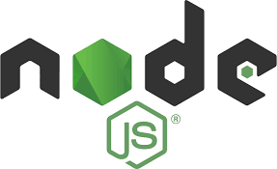
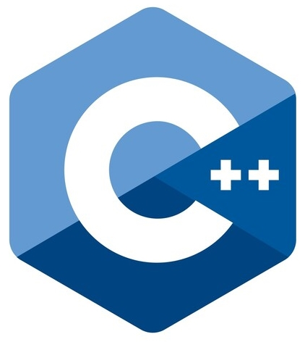
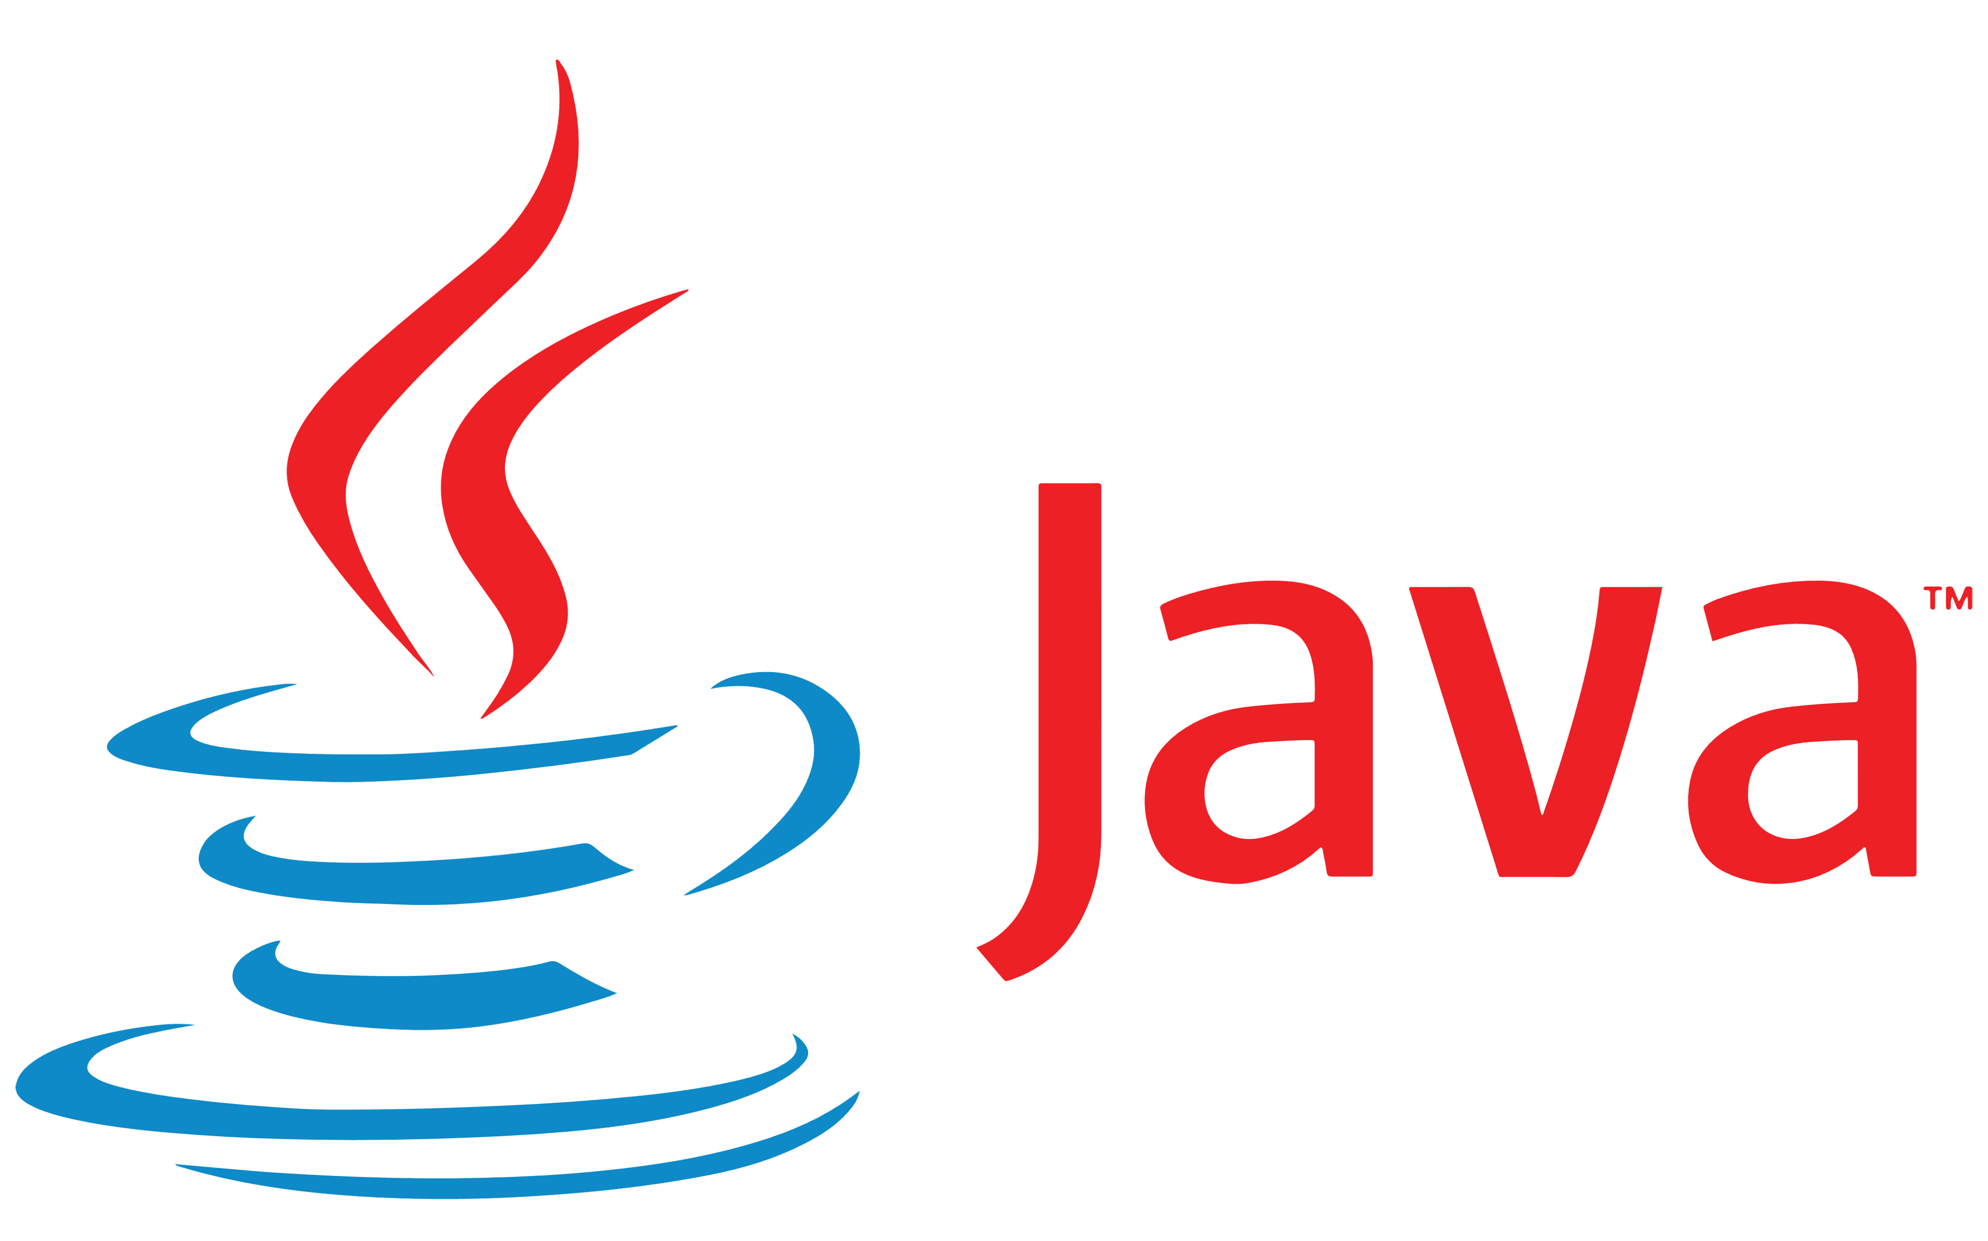













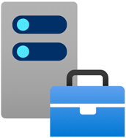

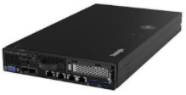

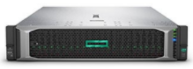
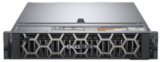
Azure Stack HCI hybrid all up
Hybrid Services
Azure Arc
For cloud management
Site Recovery
Applications
Backup
Azure Portal
Update Management
Windows
Linux
Containers
Cognitive
Services
Data
Services
Azure Arc
File Sync
Virtual machines
Any size and configuration
Azure Kubernetes Service
Managed container platform
Monitor
Azure Stack HCI
Hyperconverged infrastructure software stack
Security Center
Hardware ecosystem
200+ solutions, validated by Microsoft
Windows Admin Center
Edge-local management

Slide 30
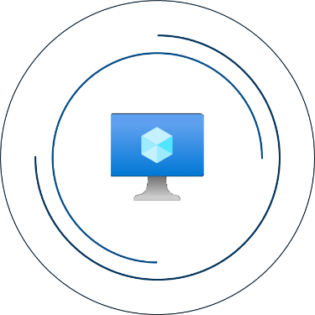
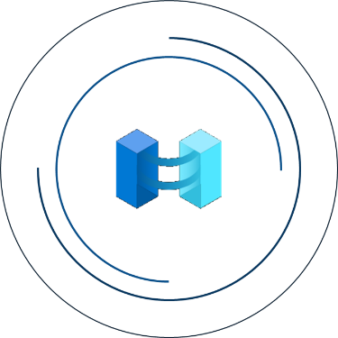

What’s new for Azure Stack HCI in 2022
Azure workloads and benefits
Azure management and governance
Azure infrastructure innovation

Slide 31









Azure workloads and benefits
on Azure Stack HCI

Slide 32



Windows Server better-together
with Azure Stack HCI, version 21H2
For newer workloads…
For older workloads…
For all Windows Server workloads…
Windows Server 2022 Azure Edition
Free extended security updates (ESUs)
Convenient inherited activation (AVMA)
Special version of Windows Server for Azure VMs only, with unique benefits
Hot patching (no restart)Coming Soon
Azure Extended Network
SMB over QUIC
Lift and shift onto Azure Stack HCI to secure older workloads on-premises
Windows Server 2008/R2
Windows Server 2012/R2
SQL Server 2008/R2
SQL Server 2012/R2
Simplify licensing with Automatic Virtual Machine Activation
Option 1: Enter key into host
Option 2: Add-on subscription

Slide 33
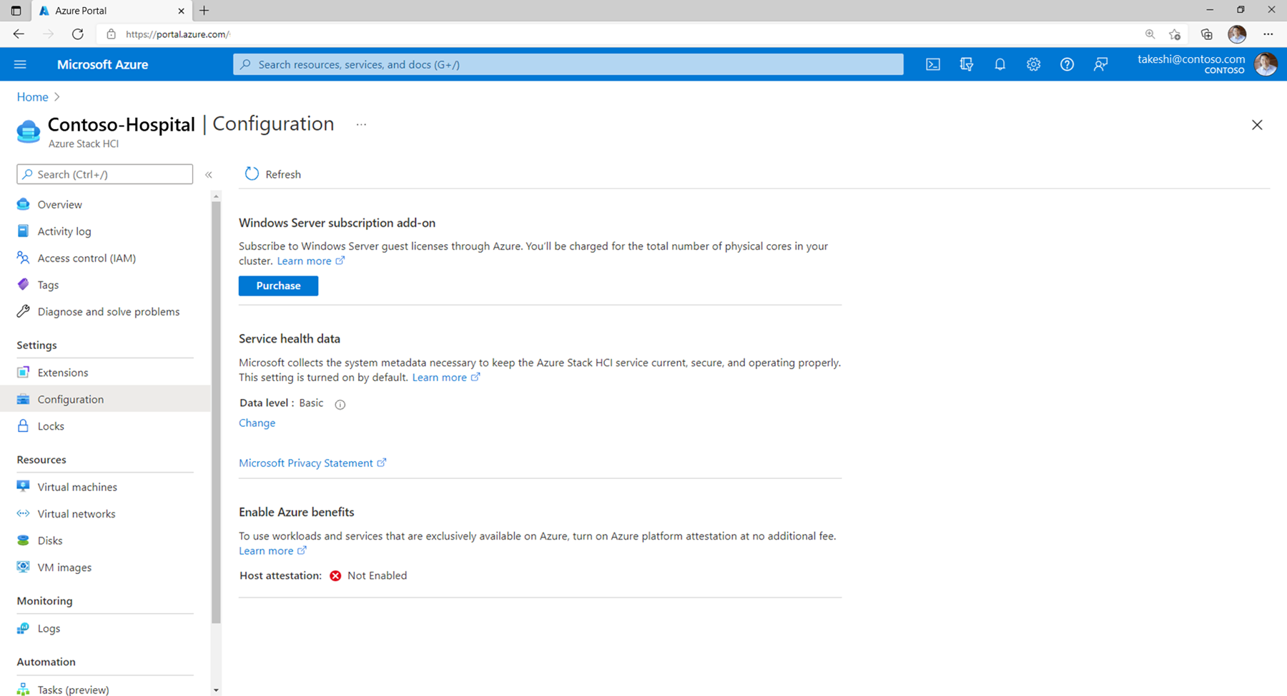

Slide 34









Azure management and governance
for Azure Stack HCI

Slide 35
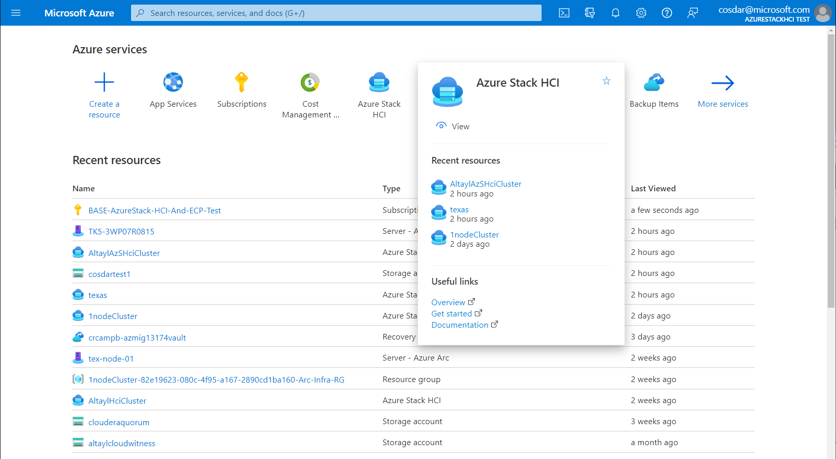
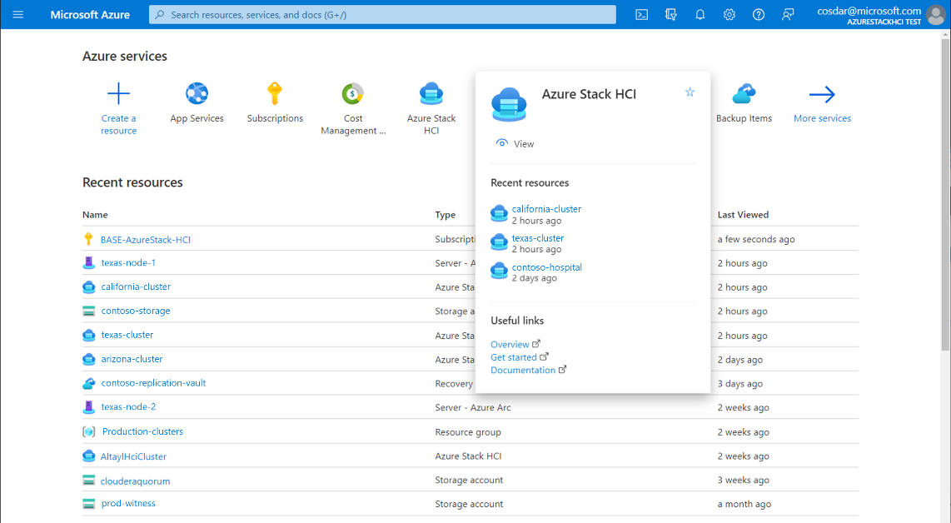
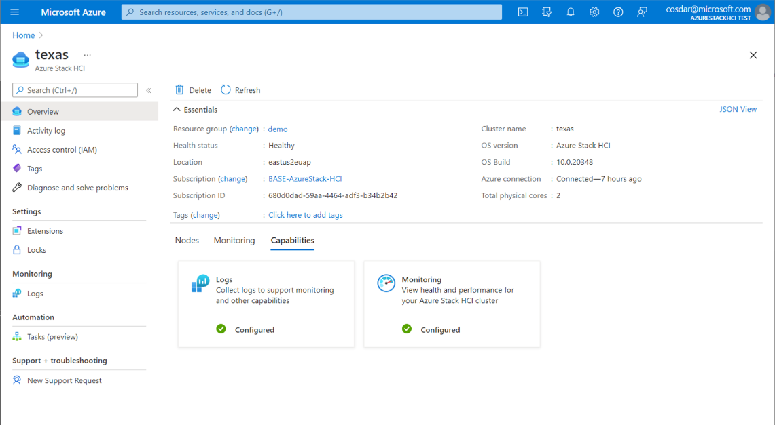



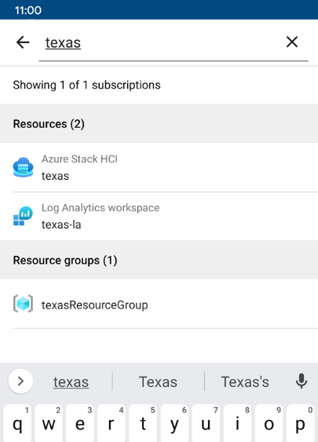


Azure Stack HCI integrates with Azure Resource Manager
Azure management tools Azure Portal, CLI/SDK, and Mobile App
Tags and search Find resources across all your environments
Role-based access control Identity access management
Governance Enforce standards with Azure Policy

Slide 36


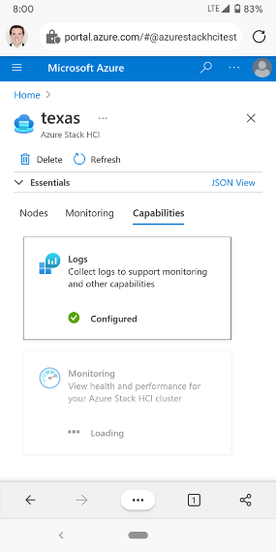
Easily install powerful management extensions
Lifecycle management Add, modify, update, or remove extensions
Stay in Azure Portal No need to copy files, run installer, etc.
Cluster-aware One click applies to all nodes
Persisted intent-based Applies to new/replacement nodes

Slide 37
Demo

Slide 38




Multi-cluster monitoring in the Azure Portal
with Azure Monitor Insights for Azure Stack HCI (preview)
Azure-native solution
Nothing to integrate, no database or third-party software to manage
Highly scalable
Scales to 100s of clusters, independent of domain or physical location
Customizable
Visualizations and underlying queries are extensible by users or integrators

Slide 39
Demo

Slide 40





How it works: multi-cluster monitoring Azure Monitor Insights, Workbooks, and Log Analytics
Customer’s subscription
Cluster-RG
Custom “Insights” solution
4
Cluster
Stack HCI resource
Workbook template
User
Azure Portal
Cluster-Nodes-RG
Logs-RG
3
3
3
On every node, Azure Arc installs the Microsoft Monitoring Agent (MMA)
Log Analytics workspace
1
2
MMA collects logs from Health Service and uploads to Log Analytics workspace in the customer’s subscription
2
2
2
Cloud
On-premises
3
Microsoft-provided “Insights” solution has Workbook template with queries and visualizations for immediate value
1
1
1
Arc Agent
Az Mon Agent
Arc Agent
Az Mon Agent
Arc Agent
Az Mon Agent
HCI OS
HCI OS
HCI OS
4
User can access in Azure Monitor or directly from Azure Stack HCI resource
Physical Host 1
Physical Host 2
Physical Host 3
Azure Stack HCI Cluster

Slide 41
Azure Virtual Desktop for Azure Stack HCI (preview)

Slide 42




Azure Virtual Desktop for Azure Stack HCI (preview)
Extending the benefits of cloud-managed VDI to on-premises
Cloud control plane
Fully managed, cloud-hosted VDI management plane
End-user experience
Windows 10 and 11 Enterprise multi-session
Lower latency
Direct access to local session hosts with RDP Shortpath

Slide 43
Demo

Slide 44


Review of Azure workloads and benefits
available on Azure Stack HCI, version 21H2
Windows Server
Azure Edition (Preview), free ESUs, pay-as-you-go
Azure Kubernetes Service
Deploy and manage Windows and Linux containers
PaaS services
(preview)
Managed SQL, App services, Functions, Logic Apps
Azure Virtual Desktop (preview)
Cloud-hosted control plane, Windows multi-session

Slide 45





Roadmap: Extensions planned for Azure Stack HCI Adding powerful new functionality through the extension mechanism
…
Monitoring
Management
Automanage
Disaster recovery
PowerShell
And stay tuned for others!
MMA/AMA ext.
WAC-in-Portal ext.
Guest Configuration ext.
ASR H2A agent ext.
Run Cmd v2 ext.
Send logs, metrics, alerts from OS to Azure Monitor
Depth management without leaving Portal
Audit and remediate OS configuration via DSC
Replicate VMs into Recovery Services Vault
Run any cmdlet or script against one or every node
Public Preview
In development
Private Preview
In development
In planning

Slide 46
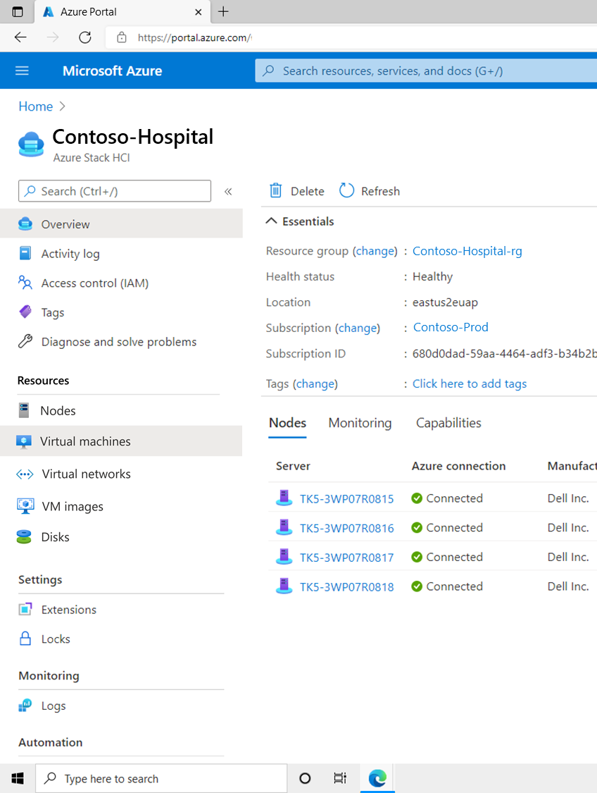
Preview
Provision and manage VMs from the Azure Portal

Slide 47




Provision and manage VMs from the Azure Portal
with Arc-enabled VM management for Azure Stack HCI (preview)
COMING SOON
Azure Portal
Consistent user experience across cloud and edge
ARM templates
Automate VM deployments with ARM templates
RBAC and self-service
Users can access their VMs only, not the host fabric
Arc-enabled guests
Manage and monitor the guest OS and apps

Slide 48
Demo

Slide 49


Azure Backup and Azure Site Recovery
Official support for Azure Stack HCI, version 21H2
Azure Backup
Azure Site Recovery
With MABS v3 UR2, backup Azure Stack HCI host (System State/BMR) and VMs running on the Azure Stack HCI cluster.
“Hyper-V to Azure” scenario has been validated and docs will be updated to show support when 21H2 is generally available.
Supported
Supported

Slide 50









Azure infrastructure innovation
for Azure Stack HCI

Slide 51






Azure infrastructure innovation
in the 21H2 feature update
Kernel soft reboot
Software-only restart that skips pre-boot sequence incl. hardware POST. Up to 10x faster than cold reboot.
GPUs for AI/ML
Assign whole GPUs (DDA) to clustered virtual machines, which can failover for high availability.
Dynamic CPU compatibility
Minimize performance degradation when mixing processor generations in same cluster.
Thin provisioning
Size and allocate Storage Spaces Direct data volumes independent of how much physical capacity is installed.
Network ATC
Intent-based configuration for IPs, VLANs, vSwitch, SET, and more. Propagates cluster-wide and corrects drift.
Secured-Core Server
Baseline assurance of hardware, firmware, and OS hardening to defend against current and future threats.

Slide 52



High availability for GPU workloads
with GPU pools in Azure Stack HCI, version 21H2
New
Ideal for AI/ML
Deliver whole-GPU acceleration to your most demanding workloads
Clustering
Failover cluster manages placement and GPU resources
Automatic failover
After host failure, VM automatically assigned GPU from another node
Easy to manage
Integrates with PowerShell and Windows Admin Center

Slide 53
Mobility and failover scenarios with GPUs
For clustered VMs on Azure Stack HCI, version 21H2
# | Scenario | Outcome with version 21H2
1 | Automatic VM failover after unexpected node down | ✔ VM moves to node with GPU available and starts
2a | Set VM default offline action to Shutdown, then Move to different node | ✔ VM starts on the new node, gets GPU if any
2b | Pause/drain cluster node | ✔ VM starts on the new node, gets GPU if any
2c | Cluster-aware updating pause/drain node | ✔ VM starts on the new node, gets GPU if any
3 | Live migrate running VM with GPU assignment to another node | ❌ No … not yet

Slide 54
Licensing

Slide 55


What does Azure Stack HCI charge for?
Cores
80
70
60
50
40
30
20
10
Cores from running virtual machines
USD $10/month
per physical processor core*
Physical cores
*Does not include Guest OS licensing
0 1 2 3 4 5 6 7 8 9 10 11 12 13 14 15 16 17 18 19 20 21 22 23 24 25 26 27 28 29 30
Days
Predictable
Doesn’t vary with consumption, more VMs doesn’t cost more
Simple
No math with memory, storage, or network ingress/egress
Rewards
Those who virtualize efficiently, with higher v-to-p density

Slide 56

How does it work: License guests and apps separately
As little or as much Windows Server as you need, like other HCI offerings in the market
What you want to run:
Linux applications
Open-source software
What you buy:
OEM HW
+
Azure Stack HCI
+
Nothing else from Microsoft
See provider if fees apply
What you want to run:
A few Windows Server roles or applications
What you buy:
Validated OEM HW
+
Azure Stack HCI
+
Windows Server 2019 Standard(s)
What you want to run:
Unlimited Windows Server roles or applications
What you buy:
Validated OEM HW
+
Azure Stack HCI
+
Windows Server 2019 Datacenter
Host: Subscription
Guest: Perpetual

Slide 57
https://azurestackhci.slack.com/

Slide 58
Slides and demos from the conference will be available at
https://github.com/nordicinfrastructureconference/2022

